Slide 1
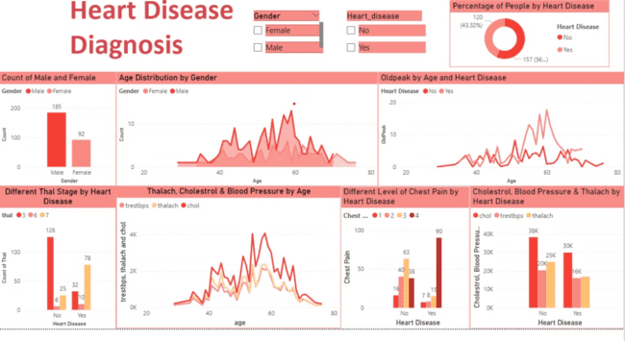

Heart Disease Diagnosis: A BI Project
This presentation outlines a Business Intelligence (BI) project. It focuses on enhancing heart disease diagnosis. Created by Jay Kumar Binawara, it details the project's functionalities and real-world problem-solving capabilities.
by Jay Binawara

Slide 2
Project Workflow Overview
Data Collection
Data Cleaning
Analysis and Modelling
Gathering patient data. Including medical history and test results.
Removing inconsistencies and errors for analysis.
Applying algorithms for accurate diagnosis.
The project is streamlining the diagnosis process. It improves accuracy in identifying potential heart conditions early.

Slide 3

Real-World Problem Solving
Early Detection
Resource Allocation
Identifying risks before critical stages.
Optimising healthcare resource usage.
Treatment Planning
Personalising treatments based on patient data.

Slide 4
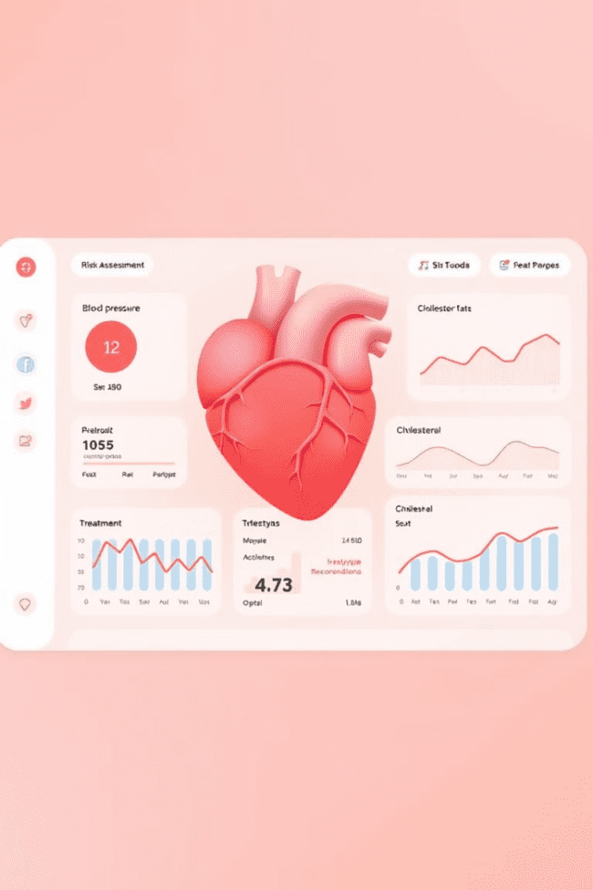



Features of the BI Project
Interactive Dashboards
Predictive Analytics
Data Visualisation
These features enable healthcare professionals. To make informed decisions quickly. It enhances patient care through data-driven insights.

Slide 5




Addressing Diagnostic Delays
Data Integration
Centralizing patient information.
Automated Analysis
Rapid processing of test results.
Alert System
Prompting immediate action for high-risk cases.
Reducing time between testing and diagnosis. Improves patient outcomes significantly.

Slide 6




Enhanced Accuracy in Diagnosis
Refined Algorithms
Reducing false positives and negatives.
Comprehensive Data Review
Analysing various risk factors holistically.
Personalised Risk Assessments
Tailoring diagnoses to individual patient profiles.

Slide 7



Resource Optimisation
2
Improved Efficiency
Streamlining diagnostic processes.
Cost Reduction
Lowering expenses through efficient resource management.
1
Better Allocation
3
Distributing resources based on needs.
Ensuring healthcare facilities use their budgets. More effectively and focus on critical patient requirements.

Slide 8

Key Takeaways and Next Steps
85%
40%
Improved diagnostic accuracy.
Reduction in diagnostic delays.
25%
Optimized resource use.
Implementing this BI project revolutionises heart disease diagnosis. Future steps include scaling the project to more hospitals.

